Slide 1
Webcams – Graphics Assignment 05
Akarsh Kumar

Slide 2
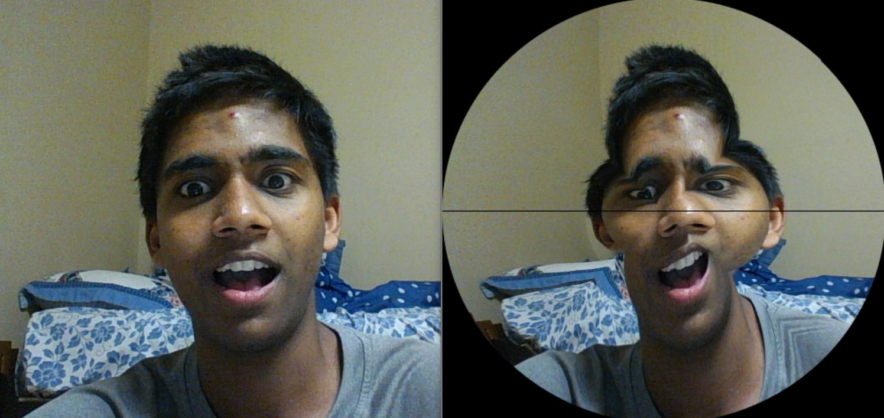
Filter 1
Main Filter (hardest to make):
Transform square to oval
Transfer each side of square to a given quadrant in oval
Scale the square’s parameter to the oval parameter by using angle scaling

Slide 3
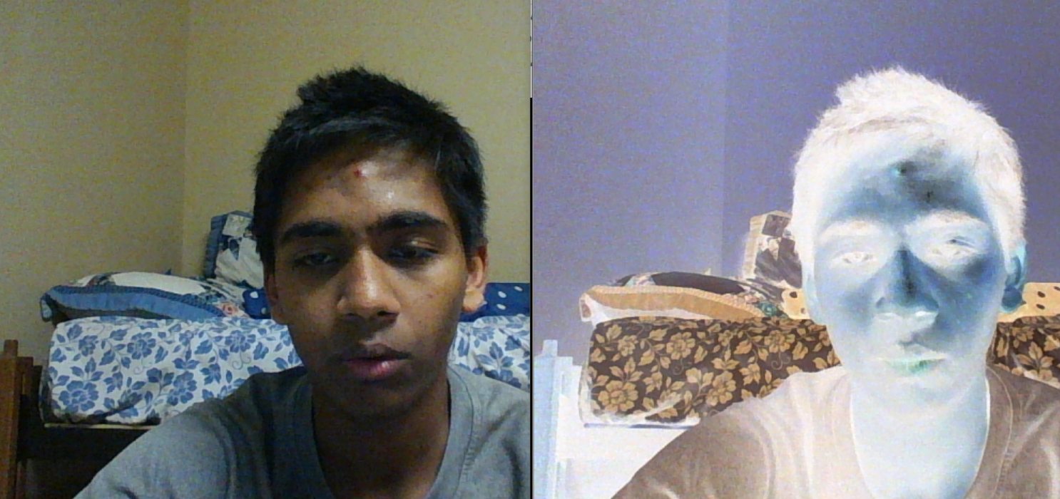
Filter 2
Invert Colors

Slide 4
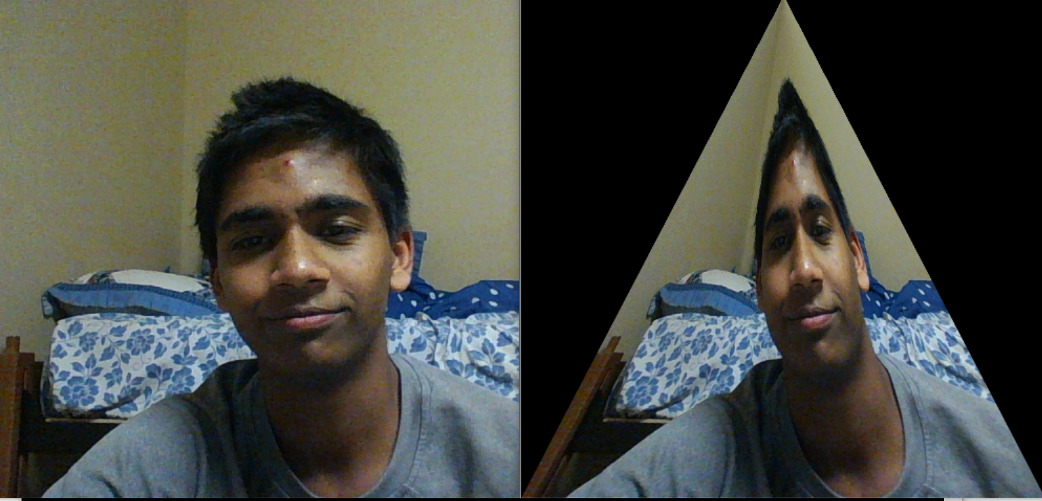
Filter 3
Scale to triangle, based on y values

Slide 5
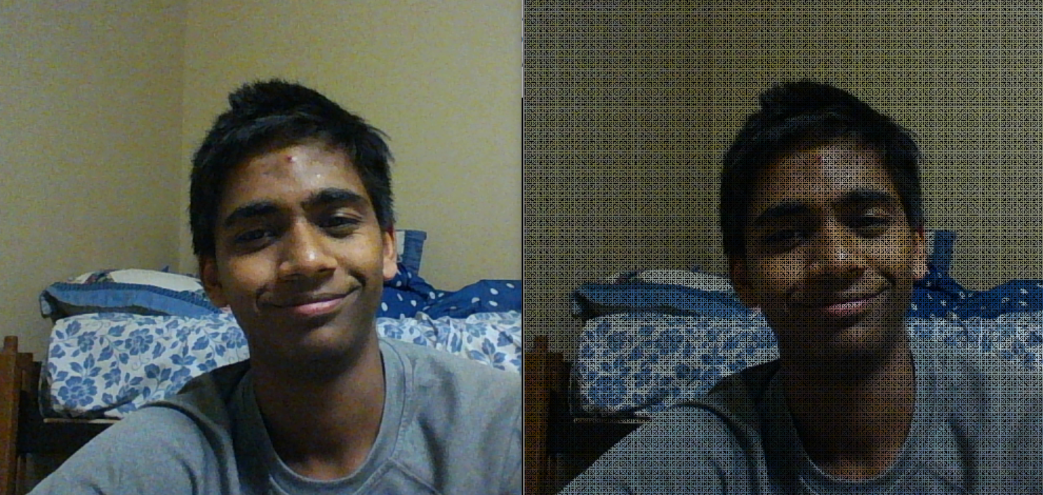
Filter 4
Dimmer image, color every prime pixel up to every 7 black

Slide 6
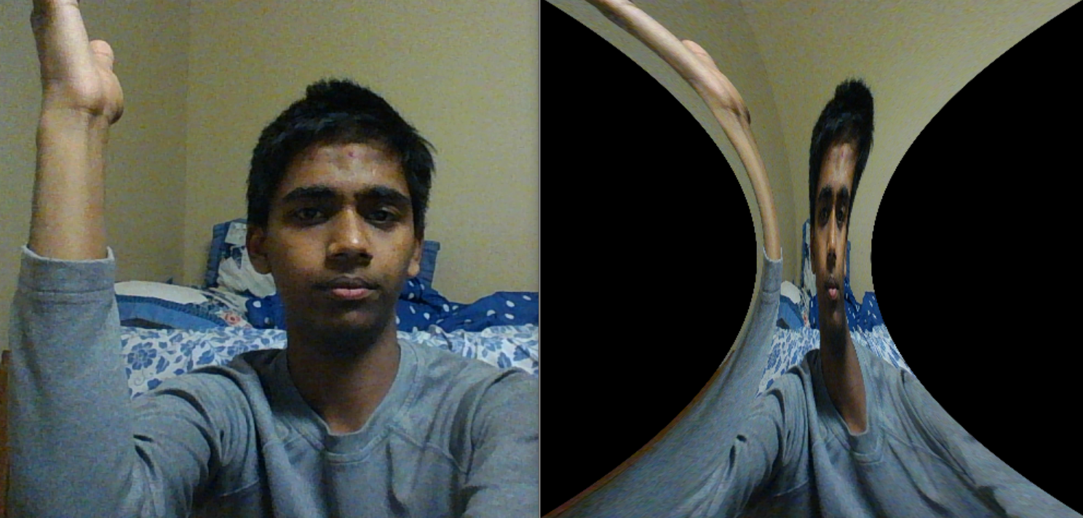
Filter 5
Hyperbolic stretch

Slide 7
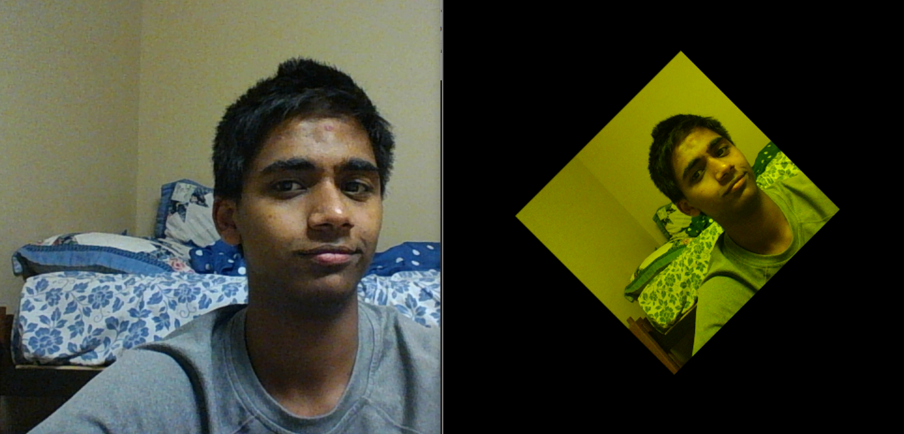
Filter 6
Rotate and change color

